Slide 1
Level 1 Exam Presentation Declarative Analytics on Heterogeneous Exascale Systems
Ahmedur Rahman Shovon
Supervisor: Dr. Sidharth Kumar
Semester: Spring 2023 Date: April 26, 2023
Department of Computer Science University of Alabama at Birmingham

Slide 2
Table of Contents
Exascale Computing
Iterative Relational Algebra
Datalog
Declarative Analytics using Datalog Applications
Topological Data Analysis for High-Dimensional Data
Future Research Direction

Slide 3
Table of Contents
Exascale Computing
Iterative Relational Algebra
Datalog
Declarative Analytics using Datalog Applications
Topological Data Analysis for High-Dimensional Data
Future Research Direction

Slide 4
What is Exascale?
Rank | Site | Computer | Cores | HPL-AI (Eflop/s)
1 | DOE/SC/ORNL | Frontier | 8,730,112 | 7.942
2 | EuroHPC/CSC | LUMI | 2,174,976 | 2.168
3 | RIKEN | Fugaku | 7,630,848 | 2.000
4 | EuroHPC/CINECA | Leonardo | 1,463,616 | 1.842
5 | DOE/SC/ORNL | Summit | 2,414,592 | 1.411
6 | NVIDIA | Selene | 555,520 | 0.630
7 | DOE/SC/LBNL | Perlmutter | 761,856 | 0.590
8 | FZJ | JUWELS BM | 449,280 | 0.470
9 | GENCI-CINES | Adastra | 319,072 | 0.303
10 | Pawsey Supercomputing Centre | Setonix - GPU | 181,248 | 0.175
11 | University of Florida | HiPerGator | 138,880 | 0.170
12 | SberCloud | Christofari Neo | 98,208 | 0.123
13 | DOE/SC/ANL | Polaris | 259,840 | 0.114
14 | ITC | Wisteria | 368,640 | 0.100
15 | NSC | Berzelius | 59,520 | 0.050
Ability of a computer system to perform 1 Exaflop or more
1 Exaflop = 1 quintillion flop (10¹⁸) or 10⁹ Gigaflop
Capacity?
Perform as many calculations as about
50 million laptops! Speed? A trillion times faster than a PC!
HPL-MxP benchmark of high-performance computing (HPC) and artificial intelligence (AI) workloads from November 2022
Merritt, R. (2022, September 16). What is an exaflop? NVIDIA Blog. Retrieved April 9, 2023, from https://blogs.nvidia.com/blog/2022/07/26/what-is-an-exaflop/
Luszczek, P. (2022, November). HPL-MxP Results. HPL. Retrieved April 9, 2023, from https://hpl-mxp.org/results.md
Webstudios, G. (2021, August 31). Why countries are competing to build supercomputers? Griffon Webstudios. Retrieved April 9, 2023, from https://griffonwebstudios.com/build-super-computers/

Slide 5



Exascale Computing Project
Exascale Computing Project (ECP) initiated in 2016 for High-Performance Computing (HPC)
Administered by US Department of Energy Office of Science and the National Nuclear Security Administration
3 new exascale systems will be launched in 2023-2024
Evans, T. M., Siegel, A., Draeger, E. W., Deslippe, J., Francois, M. M., Germann, T. C., ... & Martin, D. F. (2022). A survey of software implementations used by application codes in the Exascale Computing Project. The International Journal of High Performance Computing Applications, 36(1), 5-12.
D. Kothe, S. Lee and I. Qualters, "Exascale Computing in the United States," in Computing in Science & Engineering, vol. 21, no. 1, pp. 17-29, 1 Jan.-Feb. 2019, doi: 10.1109/MCSE.2018.2875366.

Slide 6
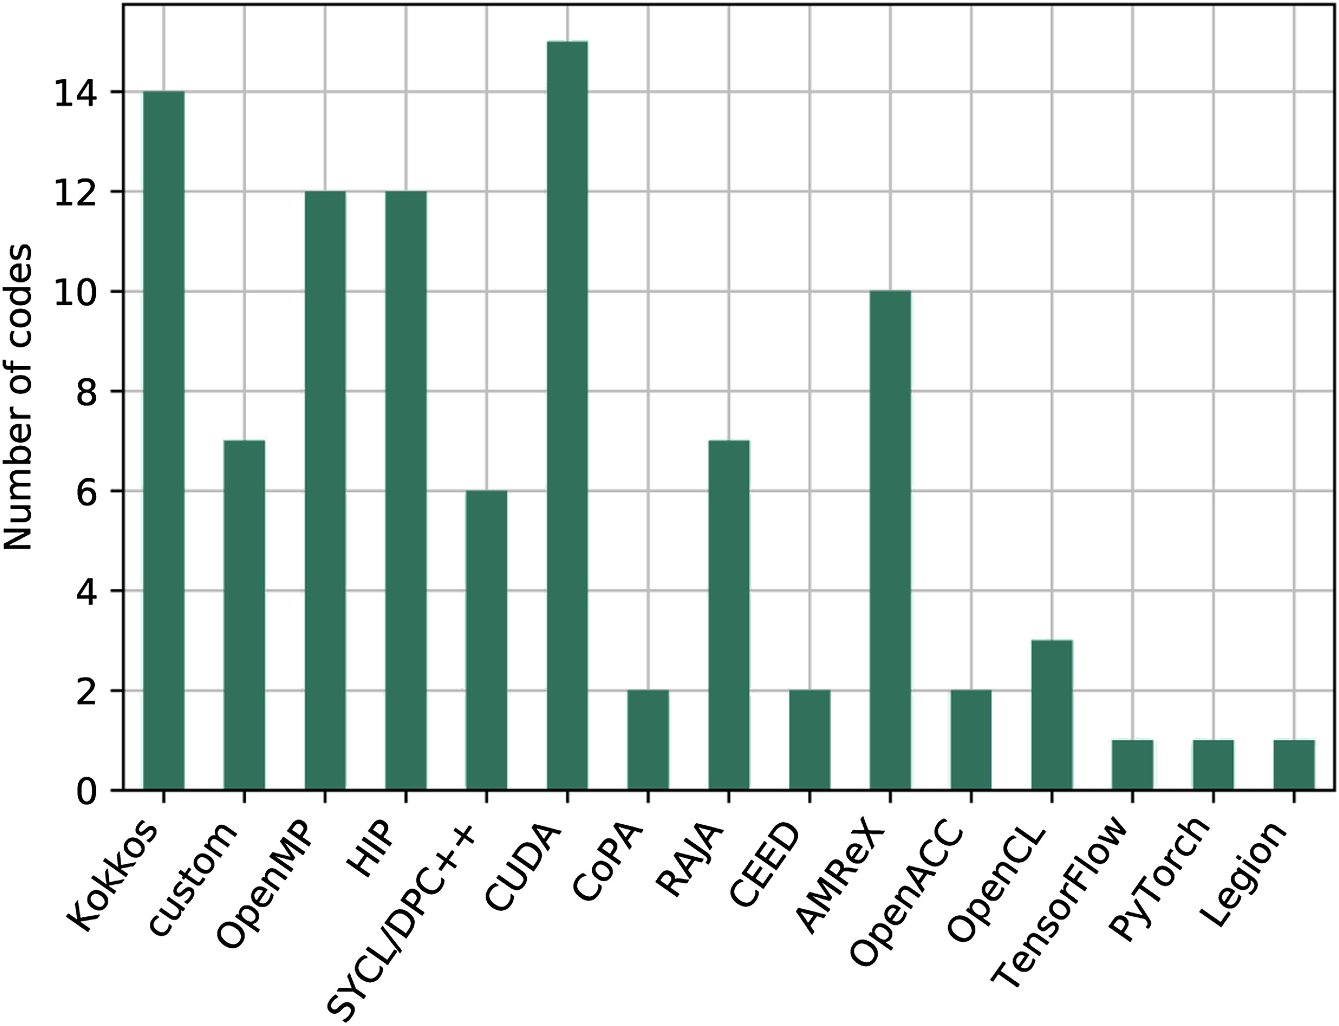
Exascale Computing Models
Heterogeneous
22 combinations of GPU
Most common: CUDA
Evans, T. M., Siegel, A., Draeger, E. W., Deslippe, J., Francois, M. M., Germann, T. C., ... & Martin, D. F. (2022). A survey of software implementations used by application codes in the Exascale Computing Project. The International Journal of High Performance Computing Applications, 36(1), 5-12.

Slide 7
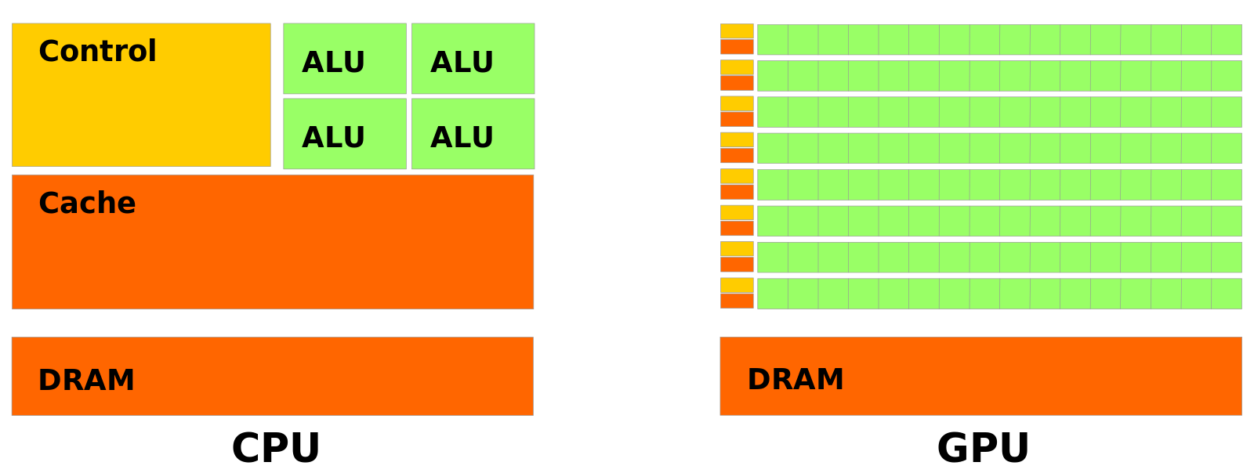
GPGPU
General Purpose computing using GPU
Influenced the High-Performance Computing (HPC) paradigms
Offers thousands of cores
Power efficiency TFlop per Watt
File:Cpu-gpu.svg. (2020, October 1). Wikimedia Commons. Retrieved 18:08, April 10, 2023 from https://commons.wikimedia.org/w/index.php?title=File:Cpu-gpu.svg&oldid=477433509.
Levinas, M. (2020, November). What is GPU computing and how is it applied today? What Is GPU Computing And How Is It Applied Today? Retrieved from https://blog.cherryservers.com/what-is-gpu-computing
Notes:
General Purpose computing using GPU for parallel independent calculations
Became popular in the mid-2000s
Influenced the High-Performance Computing paradigms
Performance: offers thousands of cores
Power efficiency: in terms of TFlop per Watt

Slide 8
GPGPU Challenges
Coupled with complex hierarchies of memory subsystems
GPU architectures differ from the traditional multicore CPUs
Requires to redesign of algorithms executed on a deterministic sequence
Gerassimos Barlas. Chapter 6 - gpu programming. In Gerassimos Barlas, editor, Multicore and GPU Programming, pages 391–526. Morgan Kaufmann, Boston, 2015.
J. D. Owens, M. Houston, D. Luebke, S. Green, J. E. Stone and J. C. Phillips, "GPU Computing," in Proceedings of the IEEE, vol. 96, no. 5, pp. 879-899, May 2008, doi: 10.1109/JPROC.2008.917757.

Slide 9
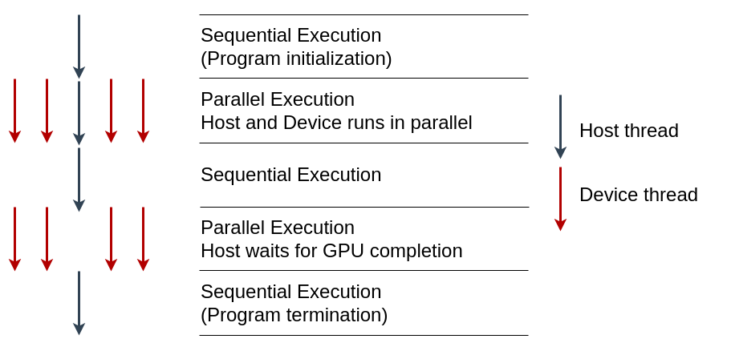
CUDA Programming Model
Globally Sequential Locally Parallel programming pattern
Invokes parallel kernels that execute across a set of threads
CUDA spawns the threads from a hierarchy of grid (3D) and block (3D)
Each thread executes an instance of the kernel
Each thread has thread ID, program counter, registers, and per-thread private memory
Supports C/C++, Fortan, Python
Jason. Sanders. CUDA by example : an introduction to general-purpose GPU programming. Addison-Wesley, Upper Saddle River, NJ, 2011.
Jianbin Fang, Chun Huang, Tao Tang, and Zheng Wang. Parallel programming models for heterogeneous many-cores: a comprehensive survey. CCF Transactions on High Performance Computing, 2(4):382–400, 2020.

Slide 10
Table of Contents
Exascale Computing
Iterative Relational Algebra
Datalog
Declarative Analytics using Datalog Applications
Topological Data Analysis for High-Dimensional Data
Future Research Direction

Slide 11
Relational Algebra Primitives
Main relational algebra primitives of two flat relations R and S are:
Union: R ∪ S
Intersection: R ∩ S
Cartesian product: R × S
Join: R⨝S
Rename: ρ_{(i,j)}(R)
Selection: σ_{i}(R)
Projection: Π_{(i,j)}(R)
Differ from traditional set theory: R and S have a fixed arity
Relation
UserID | UserName | UserEmail
101 | Alice | alice@example.com
102 | Bob | bob@example.com
Tuple
(Row)
Attribute (Column)
Sidharth Kumar and Thomas Gilray. Distributed relational algebra at scale. In International Conference on High Performance Computing, Data, and Analytics (HiPC). IEEE, 2019.
Sidharth Kumar and Thomas Gilray. Load-balancing parallel relational algebra. In International Conference on High Performance Computing, pages 288–308. Springer, 2020.

Slide 12
Why Join is Important in RA?
Combine data from multiple tables
Find patterns in data
Clean data
Create new data sets
Daniel Zinn, Haicheng Wu, Jin Wang, Molham Aref, and Sudhakar Yalamanchili. General-purpose join algorithms for large graph triangle listing on heterogeneous systems. In Proceedings of the 9th Annual Workshop on General Purpose Processing Using Graphics Processing Unit, pages 12–21, 2016.

Slide 13
Example of Natural Join ⨝
User
UserID | UserName | UserEmail
101 | Alice | alice@example.com
102 | Bob | bob@example.com
103 | Eve | eve@example.com
⨝
Order
UserID | OrderTotal | Items
101 | 25.69 | 2
102 | 145.66 | 3
103 | 12.11 | 1
103 | 44.00 | 2

Slide 14
Example of Natural Join ⨝
User
UserID | UserName | UserEmail
101 | Alice | alice@example.com
102 | Bob | bob@example.com
103 | Eve | eve@example.com
⨝
User
Order
⨝
UserID | UserName | UserEmail | OrderTotal | Items
101 | Alice | alice@example.com | 25.69 | 2
102 | Bob | bob@example.com | 145.66 | 3
103 | Eve | eve@example.com | 12.11 | 1
101 | Alice | alice@example.com | 44.00 | 2
Order
UserID | OrderTotal | Items
101 | 25.69 | 2
102 | 145.66 | 3
103 | 12.11 | 1
103 | 44.00 | 2

Slide 15
Example of Natural Join ⨝
User
UserID | UserName | UserEmail
101 | Alice | alice@example.com
102 | Bob | bob@example.com
103 | Eve | eve@example.com
⨝
User
Order
⨝
UserID | UserName | UserEmail | OrderTotal | Items
101 | Alice | alice@example.com | 25.69 | 2
102 | Bob | bob@example.com | 145.66 | 3
103 | Eve | eve@example.com | 12.11 | 1
101 | Alice | alice@example.com | 44.00 | 2
Order
UserID | OrderTotal | Items
101 | 25.69 | 2
102 | 145.66 | 3
103 | 12.11 | 1
103 | 44.00 | 2

Slide 16
Example of Natural Join ⨝
User
UserID | UserName | UserEmail
101 | Alice | alice@example.com
102 | Bob | bob@example.com
103 | Eve | eve@example.com
⨝
User
Order
⨝
UserID | UserName | UserEmail | OrderTotal | Items
101 | Alice | alice@example.com | 25.69 | 2
102 | Bob | bob@example.com | 145.66 | 3
103 | Eve | eve@example.com | 12.11 | 1
101 | Alice | alice@example.com | 44.00 | 2
Order
UserID | OrderTotal | Items
101 | 25.69 | 2
102 | 145.66 | 3
103 | 12.11 | 1
103 | 44.00 | 2

Slide 17
Example of Natural Join ⨝
User
UserID | UserName | UserEmail
101 | Alice | alice@example.com
102 | Bob | bob@example.com
103 | Eve | eve@example.com
⨝
User
Order
⨝
UserID | UserName | UserEmail | OrderTotal | Items
101 | Alice | alice@example.com | 25.69 | 2
102 | Bob | bob@example.com | 145.66 | 3
103 | Eve | eve@example.com | 12.11 | 1
103 | Eve | eve@example.com | 44.00 | 2
Order
UserID | OrderTotal | Items
101 | 25.69 | 2
102 | 145.66 | 3
103 | 12.11 | 1
103 | 44.00 | 2

Slide 18
Duplicates on Join Result
User ⨝ Order
UserID | UserName | UserEmail | OrderTotal | Items
101 | Alice | alice@example.com | 25.69 | 2
102 | Bob | bob@example.com | 145.66 | 3
103 | Eve | eve@example.com | 12.11 | 1
103 | Eve | eve@example.com | 44.00 | 2
Π(_{UserName,UserEmail})(User ⨝ Order)
UserName | UserEmail
Alice | alice@example.com
Bob | bob@example.com
Eve | eve@example.com
Eve | eve@example.com

Slide 19
Parallel Join
What: Perform relational join operation simultaneously on a number of processors or machines
When: Useful when input data is enormous and the join is computationally costly
How: Divide the data into partitions and assign each partition to a different processor
Daniel Zinn, Haicheng Wu, Jin Wang, Molham Aref, and Sudhakar Yalamanchili. General-purpose join algorithms for large graph triangle listing on heterogeneous systems. In Proceedings of the 9th Annual Workshop on General Purpose Processing Using Graphics Processing Unit, pages 12–21, 2016.

Slide 20
Parallel Join (Continue)
Design
Consider partition, load balancing, communication
Challenging due to the uncertain output size
Efficient joins requires sorting or indexing
Optimize
Implement
Daniel Zinn, Haicheng Wu, Jin Wang, Molham Aref, and Sudhakar Yalamanchili. General-purpose join algorithms for large graph triangle listing on heterogeneous systems. In Proceedings of the 9th Annual Workshop on General Purpose Processing Using Graphics Processing Unit, pages 12–21, 2016.

Slide 21
Parallel Join
Parallel Join
Algorithms
Hardwares
Load balancing

Slide 22
Parallel Join: Algorithms
Popular algorithms
Non-Indexed Nested Loop Join (NINLJ)
Indexed Nested Loop Join (INLJ)
Sort-Merge Join (SMJ)
Radix Hash Join (HJ)
Sort-merge is suitable for small to medium-sized tables, radix hash join is suitable for large tables
Chengxin Guo, Hong Chen, Feng Zhang, and Cuiping Li. Parallel hybrid join algorithm on gpu. 2019IEEE 21st International Conference on High Performance Computing and Communications; IEEE17th International Conference on Smart City; IEEE 5th International Conference on Data Science andSystems (HPCC/SmartCity/DSS), pages 1572–1579, 2019.
Hongzhi Wang, Ning Li, Zheng ke Wang, and Jianing Li. Gpu-based efficient join algorithms on hadoop.The Journal of Supercomputing, 77:292 – 321, 2020.

Slide 23
Hybrid Join Algorithm
Guo et al. proposed PHYJ: SMJ with HJ join
Reduced host-to-device and device-to-host
Fused data communication with GPU execution
On a single GPU achieved up to 1.72X speedup
Can handle skewed data
No information on multiple GPUs or distributed systems
Chengxin Guo, Hong Chen, Feng Zhang, and Cuiping Li. Parallel hybrid join algorithm on gpu. 2019IEEE 21st International Conference on High Performance Computing and Communications; IEEE17th International Conference on Smart City; IEEE 5th International Conference on Data Science andSystems (HPCC/SmartCity/DSS), pages 1572–1579, 2019.
Hongzhi Wang, Ning Li, Zheng ke Wang, and Jianing Li. Gpu-based efficient join algorithms on hadoop.The Journal of Supercomputing, 77:292 – 321, 2020.
Notes:
Introduced a pipeline technique to reduce host-to-device and device-to-host bidirectional communication costs by fusing data communication with GPU execution on setting the input and output relation

Slide 24
Parallel Join
Parallel Join
Algorithms
Hardwares
Load balancing

Slide 25
Join on CPUs: Multi-core HJ and SMJ
Barthels et al. compared HJ and SMJ on distributed multi-core systems using 4096 processor cores (MPI)
Communication inefficiencies can significantly impede performance
More cores not always means better performance, sometimes degrade
Bounded by the low computation capacity of CPUs and higher communication costs
Claude Barthels, Ingo M¨uller, Timo Schneider, Gustavo Alonso, and Torsten Hoefler. Distributed join algorithms on thousands of cores. Proc. VLDB Endow., 10(5):517–528, jan 2017.
Chengxin Guo, Hong Chen, Feng Zhang, and Cuiping Li. Distributed join algorithms on multi-cpu clusters with gpu direct rdma. Proceedings of the 48th International Conference on Parallel Processing,2019.

Slide 26
Join on CPUs: Fault Tolerant Hash Joins
Nasibullin and Novikov developed a distributed fault-tolerant hash-join
Utilizes data replication and alive signals for fault detection and recovery
Can handle a single point of failure with a keeper-worker model
Does not outperform distributed hash join algorithms in a failure-free situation
Can be criticized for data skewness and lack of accelerator use
Arsen Nasibullin and Boris Novikov. Fault tolerant distributed hash-join in relational databases. InFifth Conference on Software Engineering and Information Management (SEIM-2020), pages 11–17,2020.

Slide 27
Join on GPUs: Benchmark
Rui et al. assessed NINLJ, INLJ, SMJ, and HJ on modern GPU
Modern GPUs can lead to 20X speedup VS 7X speedup of old GPUs
Not suitable for HPC systems with multiple GPU environments
New GPU architecture is introduced (Nvidia Hopper architecture)
Bingsheng He, Ke Yang, Rui Fang, Mian Lu, Naga Govindaraju, Qiong Luo, and Pedro Sander.Relational joins on graphics processors. In Proceedings of the 2008 ACM SIGMOD internationalconference on Management of data, pages 511–524, 2008.
Ran Rui, Hao Li, and Yi-Cheng Tu. Join algorithms on gpus: A revisit after seven years. In 2015 IEEEInternational Conference on Big Data (Big Data), pages 2541–2550. IEEE, 2015.
Anne C Elster and Tor A Haugdahl. Nvidia hopper gpu and grace cpu highlights. Computing in Science& Engineering, 24(2):95–100, 2022.

Slide 28
Join on GPUs: LogiQL
Wu et al. presents Red Fox high-performance accelerator core for LogiQL queries
Outperforms multi-threaded CPU-based implementations
Novel: multi-predicate join algorithm (worst-case optimal) on GPU
Issue: deduplication of tuples and maintaining join result in sorted order
Haicheng Wu, Gregory Diamos, Tim Sheard, Molham Aref, Sean Baxter, Michael Garland, andSudhakar Yalamanchili. Red fox: An execution environment for relational query processing on gpus. InProceedings of Annual IEEE/ACM International Symposium on Code Generation and Optimization,pages 44–54, 2014.
Haicheng Wu. Acceleration and execution of relational queries using general purpose graphics processingunit (GPGPU). PhD thesis, Georgia Institute of Technology, 2015.

Slide 29
Join on GPUs: Relational Learning Framework
Expedites rule coverage on GPUs for healthcare records data
Outperforms 75% of applications over multi-core CPU systems
Duplicate tuples not efficiently managed and GPU memory overflows
Carlos Alberto Mart´ınez-Angeles, Haicheng Wu, Inˆes Dutra, V´ıtor Santos Costa, and Jorge BuenabadCh´avez. Relational learning with gpus: Accelerating rule coverage. International Journal of ParallelProgramming, 44(3):663–685, 2016

Slide 30
Join on GPUs: Control Flow Analysis (CFA)
Parallel functional CFA encoded in Datalog utilizes RA as the foundation on GPU
Extended Red Fox combining GPU parallelism with multi-node multi-core HPC
Proposed partitioned global address space (PGAS) programming model
THOMAS GILRAY and SIDHARTH KUMAR. Toward parallel cfa with datalog, mpi, and cuda. InScheme and Functional Programming Workshop, 2017.

Slide 31
Join on GPUs: WarpDrive
Jünger et al. presented a single-node multi-GPU hashing for hashjoin
Attained better memory coalescing
Hashtable insertion rate:
1.4B keys/sec (single GPU)
4.3B keys/sec (4 GPUs)
32 bit keys only with no deduplication
Incremental study: WarpCore supports 64 bit keys
Daniel J¨unger, Christian Hundt, and Bertil Schmidt. Warpdrive: Massively parallel hashing on multigpu nodes. In 2018 IEEE International Parallel and Distributed Processing Symposium (IPDPS), pages441–450. IEEE, 2018.
Daniel J¨unger, Robin Kobus, Andr´e M¨uller, Christian Hundt, Kai Xu, Weiguo Liu, and Bertil Schmidt.Warpcore: A library for fast hash tables on gpus. In 2020 IEEE 27th International Conference on HighPerformance Computing, Data, and Analytics (HiPC), pages 11–20, 2020.

Slide 32
Join on GPUs: Secondary storage
Zinn et al. presented multi-GPUs join with secondary storage support
Focused on triangle counting problem
Allow overfitting global GPU memory with SSD storage
Leapfrog Triejoin (LFTJ) algorithm: a worst-case-optimal algorithm
No mention of multi-node heterogeneous systems
Daniel Zinn, Haicheng Wu, Jin Wang, Molham Aref, and Sudhakar Yalamanchili. General-purpose joinalgorithms for large graph triangle listing on heterogeneous systems. In Proceedings of the 9th AnnualWorkshop on General Purpose Processing Using Graphics Processing Unit, pages 12–21, 2016.

Slide 33
Parallel Join
Parallel Join
Algorithms
Hardwares
Load balancing

Slide 34
Load Balancing Distributed Join
Hash-tree-based join algorithm for distributed relational algebra
Scalable TC implementation on 32K processes with size of 276B edges
Utilize MPI_Alltoallv collective operation
Identified strong scaling for hash-tree union and join operations
Potential for improvement: adaptive load balancing and memory management
Sidharth Kumar and Thomas Gilray. Distributed relational algebra at scale. In International Conferenceon High Performance Computing, Data, and Analytics (HiPC). IEEE, 2019.

Slide 35
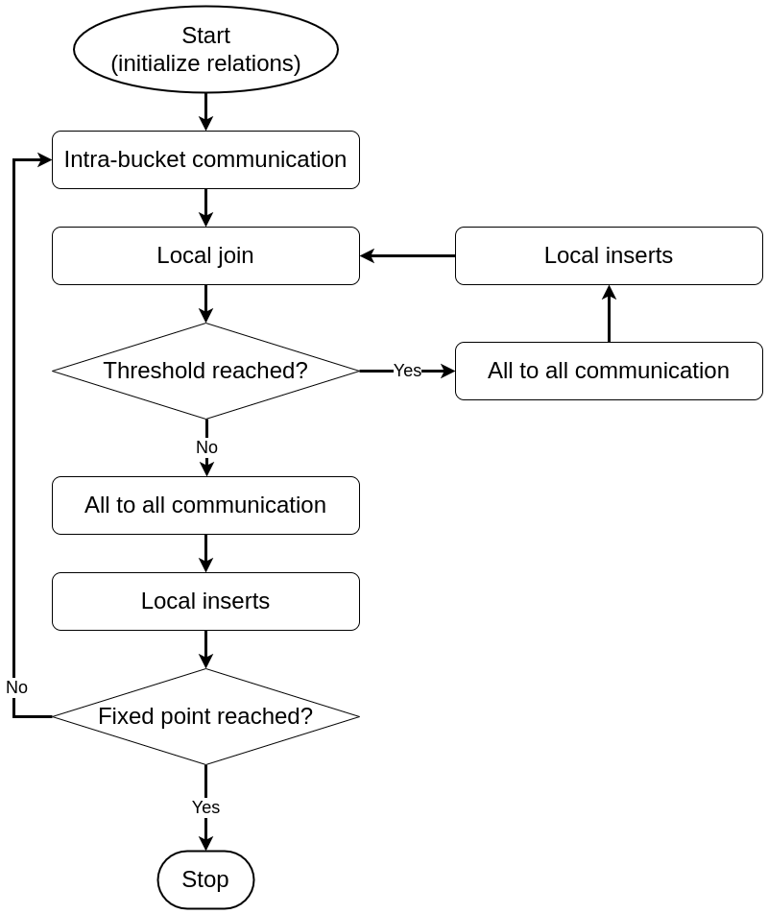
Load Balancing Multi-node Joins
2 types of load imbalance issues:
Spatial: across multiple computing nodes
Temporal: distributing newly discovered tuples
Solutions: Bucket refinement,consolidation,Iteration rollover
Range of favorable scaling exists: 256 to 32K processes
Performance deteriorates beyond that range
Handling temporal load imbalance during the join
Sidharth Kumar and Thomas Gilray. Load-balancing parallel relational algebra. In InternationalConference on High Performance Computing, pages 288–308. Springer, 2020.
Notes:
An all-to-all communication is initiated during the local-join phase once a particular threshold value is reached. This communication phase is followed by a local insertion phase where the tuples are inserted into the appropriate destination rank. The previous iteration continues precisely where it left off, as opposed to coming to an end. Next, it checks if the fixed point iteration is reached and if not it reinstates the intra-bucket communication.
Bucket refinement phase checks if subbuckets contains more tuples than average and refines their size to allow allocating the extra tuples
Bucket consolidation ensures the refined subbuckets are combined together when the spatial load balance resolved
Iteration rollover technique prevents memory overflow
Range of favorable scaling exists for workload with optimal number of processes (evaluated from 256 to 32,768 processes)
Performance deteriorates beyond that range due to less workload per process and additional communication costs

Slide 36
Table of Contents
Exascale Computing
Iterative Relational Algebra
Datalog
Declarative Analytics using Datalog Applications
Topological Data Analysis for High-Dimensional Data
Future Research Direction

Slide 37
Datalog: Bottom-Up Logic Programming Language
A lightweight logic-programming language for deductive-database systems
Running the Datalog program extends data from input database creating the output database with all data transitively derivable via the program rules
Input Database
Output Database
Datalog
(set of rules)
Ceri, S., Gottlob, G., & Tanca, L. (1989). What you always wanted to know about Datalog(and never dared to ask). IEEE transactions on knowledge and data engineering, 1(1), 146-166.
Gilray, T., Kumar, S., & Micinski, K. (2021, March). Compiling data-parallel datalog. In Proceedings of the 30th ACM SIGPLAN International Conference on Compiler Construction (pp. 23-35).

Slide 38

Datalog Example
Facts:
parents(x,y).
children(y,x).
Rules:
grandparent(x,y) :- parents(x,z), parents(z,y).
extensional
intensional
head
body
Michael Stonebraker. Readings in database systems. Morgan Kaufmann Publishers Inc., 1988
Evgeny Dantsin, Thomas Eiter, Georg Gottlob, and Andrei Voronkov. Complexity and expressivepower of logic programming. ACM Comput. Surv., 33(3):374–425, sep 2001.
David Maier, K Tuncay Tekle, Michael Kifer, and David S Warren. Datalog: concepts, history, andoutlook. In Declarative Logic Programming: Theory, Systems, and Applications, pages 3–100. 2018.

Slide 39
Datalog Timeline
1970
Horn Clauses, McCarthy
1972
Prolog, Kowalski
1975
Datalog, Maier
1977
1978
Workshop, Gallaire, Minker
LDL, Commercial
Popular, Databases
1980s
Decline, New Technologies
1990s
Regains Popularity, Semantic Web
2000s
Deductive Database, Data Mining, ML
2010s
Stefano Ceri, Georg Gottlob, Letizia Tanca, et al. What you always wanted to know about datalog(andnever dared to ask). IEEE transactions on knowledge and data engineering, 1(1):146–166, 1989
David Maier, K Tuncay Tekle, Michael Kifer, and David S Warren. Datalog: concepts, history, andoutlook. In Declarative Logic Programming: Theory, Systems, and Applications, pages 3–100. 2018.
Shan Shan Huang, Todd Jeffrey Green, and Boon Thau Loo. Datalog and emerging applications:An interactive tutorial. In Proceedings of the 2011 ACM SIGMOD International Conference onManagement of Data, SIGMOD ’11, page 1213–1216, New York, NY, USA, 2011. Association forComputing Machinery.
Notes:
Here is a timeline of the development of Datalog:
1970: John McCarthy publishes the paper "A Formal Description of Data Languages". This paper introduces the concept of Horn clauses, which are the basis of Datalog.
1972: Robert Kowalski publishes the paper "Logic for Problem Solving". This paper introduces the logic programming language Prolog, which is based on Horn clauses.
1975: David Maier coins the term "Datalog".
1977: Hervé Gallaire and Jack Minker organize a workshop on logic and databases. This workshop helps to raise awareness of Datalog and its potential for database applications.
1978: The first commercial Datalog system, called LDL, is released.
1980s: Datalog becomes increasingly popular for database applications.
1990s: The development of new database technologies, such as object-oriented databases and relational databases with triggers, leads to a decline in the popularity of Datalog.
2000s: Datalog regains some popularity due to its simplicity and efficiency. It is also used in new application areas, such as the Semantic Web.
2010s: Datalog continues to be used in a variety of applications, including database querying, data mining, and machine learning.

Slide 40
Modern Implementations of Datalog
LogicBlox
Soufflé
RadLog
PRAM
SLOG

Slide 41
LogicBlox
Gradual advances in logic programming: Advancement over the years
LogiQL language: Datalog-like, null-free
LogicBlox system: Mature, enterprise-integrated
Massive financial benefits: $300B in revenue for business analytics
Molham Aref, Balder ten Cate, Todd J. Green, Benny Kimelfeld, Dan Olteanu, Emir Pasalic, Todd L.Veldhuizen, and Geoffrey Washburn. Design and implementation of the logicblox system. In Proceedingsof the 2015 ACM SIGMOD International Conference on Management of Data, SIGMOD ’15, page1371–1382, New York, NY, USA, 2015. Association for Computing Machinery

Slide 42
Soufflé
A variant of Datalog for static analysis using OpenMP
State-of-the-art implementation for multi-core CPU systems with single-node
Translates Datalog programs to optimized C++ programs
Supports limited number of threads for task-level parallelism
Cannot provide data parallelism
Herbert Jordan, Bernhard Scholz, and Pavle Suboti´c. Souffl´e: On synthesis of program analyzers. InInternational Conference on Computer Aided Verification, pages 422–430. Springer, 2016.
Thomas Gilray, Sidharth Kumar, and Kristopher Micinski. Compiling data-parallel datalog. InProceedings of the 30th ACM SIGPLAN International Conference on Compiler Construction, CC 2021,page 23–35, New York, NY, USA, 2021. Association for Computing Machinery.

Slide 43
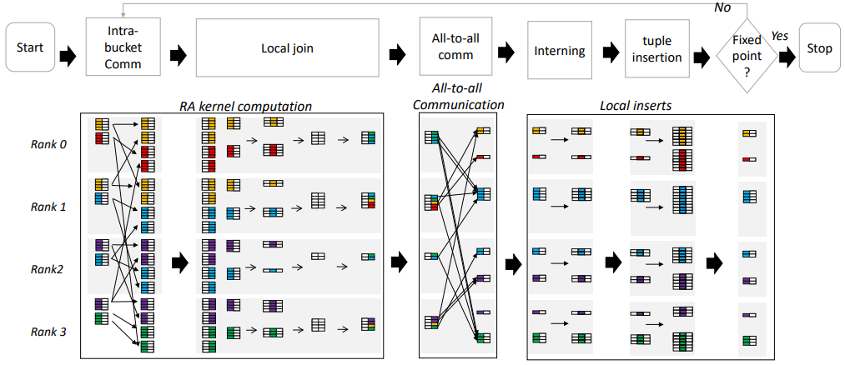
SLOG
High-performance implementation providing a compiler, REPL, and runtime
Uses PRAM as relational algebra backend
Outperforms Soufflé and RadLog for higher core counts
Does not yet utilize GPU devices
Thomas Gilray, Arash Sahebolamri, Sidharth Kumar, and Kristopher Micinski. Higher-order, dataparallel structured deduction. arXiv preprint arXiv:2211.11573, 2022.
Thomas Gilray, Sidharth Kumar, and Kristopher Micinski. Compiling data-parallel datalog. InProceedings of the 30th ACM SIGPLAN International Conference on Compiler Construction, pages23–35, 2021.

Slide 44
Table of Contents
Exascale Computing
Iterative Relational Algebra
Datalog
Declarative Analytics using Datalog Applications
Topological Data Analysis for High-Dimensional Data
Future Research Direction

Slide 45
Declarative Analytics using Datalog Applications
Declarative analytics focuses on the desired output
Declarative analytics utilizing modern Datalog implementation
Domains
Deductive database
Machine learning
Software analysis
Business analytics
Martin Bravenboer and Yannis Smaragdakis. Strictly declarative specification of sophisticated points-toanalyses. In Proceedings of the 24th ACM SIGPLAN conference on Object oriented programming systems languages and applications, pages 243–262, 2009.
Jiwon Seo, Stephen Guo, and Monica S Lam. Socialite: Datalog extensions for efficient social networkanalysis. In 2013 IEEE 29th International Conference on Data Engineering (ICDE), pages 278–289.IEEE, 2013

Slide 46
Classic Problems for Datalog
Transitive closure
Triangle counting
Finding maximal cliques
Finding frequent itemsets
Data mining
Oege De Moor, Georg Gottlob, Tim Furche, and Andrew Sellers. Datalog Reloaded: First InternationalWorkshop, Datalog 2010, Oxford, UK, March 16-19, 2010. Revised Selected Papers, volume 6702.Springer, 2012.
Jiwon Seo, Stephen Guo, and Monica S Lam. Socialite: Datalog extensions for efficient social networkanalysis. In 2013 IEEE 29th International Conference on Data Engineering (ICDE), pages 278–289.IEEE, 2013.

Slide 47
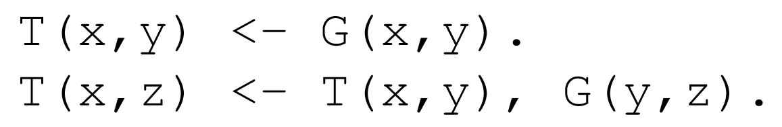
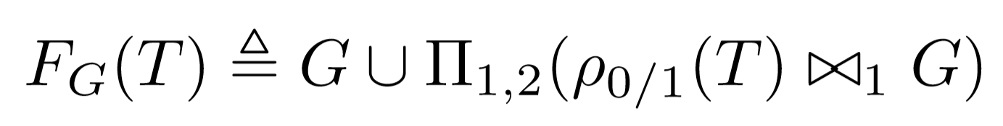
Bottom-Up Logic Programming with Datalog
Datalog rule for computing Transitive Closure (TC)
Datalog
Operationalized as a fixed-point iteration using F_{G}
Iterated
Relational Algebra
Relational algebra:
Union
Projection
Join
Gilray, T., & Kumar, S. (2019, December). Distributed relational algebra at scale. In 2019 IEEE 26th International Conference on High Performance Computing, Data, and Analytics (HiPC) (pp. 12-22). IEEE.
Kumar, S., & Gilray, T. (2020, June). Load-balancing parallel relational algebra. In International Conference on High Performance Computing (pp. 288-308). Springer, Cham.

Slide 48
Transitive Closure: Logical Inference for Graphs
1
G
1
T
T(x,y) <- G(x,y)
T(x,z) <- T(x,y),G(y,z)
0
3
4
0
3
4
2
2
0​ | 1​
0 | 2​
1​ | 3​
2​ | 3​
3 | 4
0​ | 1​
0​ | 2​
1​ | 3​
2​ | 3​
3​ | 4​
0​ | 3​
1​ | 4​
2​ | 4​
0​ | 4​

Slide 49
Transitive Closure: Iterations
1
T
0
3
4
2
0​ | 1​
0​ | 2​
1​ | 3​
2​ | 3​
3​ | 4​

Slide 50
Transitive Closure: Iterations 1
1
1
T
0
3
4
0
3
4
2
2
0​ | 1​
0​ | 2​
1​ | 3​
2​ | 3​
3​ | 4​
0​ | 1​
0​ | 2​
1​ | 3​
2​ | 3​
3​ | 4​
0​ | 3​
1​ | 4​
2​ | 4​

Slide 51
Transitive Closure: Iterations 2
1
1
1
T
0
3
4
0
3
4
0
3
4
2
2
2
0​ | 1​
0​ | 2​
1​ | 3​
2​ | 3​
3​ | 4​
0​ | 1​
0​ | 2​
1​ | 3​
2​ | 3​
3​ | 4​
0​ | 3​
1​ | 4​
2​ | 4​
0​ | 1​
0​ | 2​
1​ | 3​
2​ | 3​
3​ | 4​
0​ | 3​
1​ | 4​
2​ | 4​
0​ | 4​

Slide 52
Transitive Closure: Iterations 3
1
1
1
1
T
0
3
4
0
3
4
0
3
4
0
3
4
2
2
2
2
0​ | 1​
0​ | 2​
1​ | 3​
2​ | 3​
3​ | 4​
0​ | 1​
0​ | 2​
1​ | 3​
2​ | 3​
3​ | 4​
0​ | 3​
1​ | 4​
2​ | 4​
0​ | 1​
0​ | 2​
1​ | 3​
2​ | 3​
3​ | 4​
0​ | 3​
1​ | 4​
2​ | 4​
0​ | 4​
0​ | 1​
0​ | 2​
1​ | 3​
2​ | 3​
3​ | 4​
0​ | 3​
1​ | 4​
2​ | 4​
0​ | 4​

Slide 53
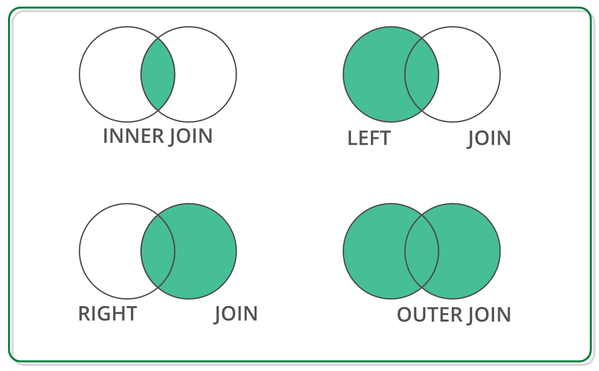
Off-the-shelf Data Structure for TC Computation
DataFrame has RA primitives APIs
DataFrame: 2D labeled tabular data structure
Reback, J., McKinney, W., Van Den Bossche, J., Augspurger, T., Cloud, P., Klein, A., ... & Seabold, S. (2020). pandas-dev/pandas: Pandas 1.0. 5. Zenodo.
Chen, D. Y. (2017). Pandas for everyone: Python data analysis. Addison-Wesley Professional.
Singh, R. (2020, July 1). Merging DataFrames with Pandas: Pd.merge(). Medium. Retrieved April 8, 2023, from https://medium.com/swlh/merging-dataframes-with-pandas-pd-merge-7764c7e2d46d

Slide 54


Off-the-shelf Python Libraries for TC Computation
DataFrame: 2D labeled tabular data structure
GPU (NVIDIA)
CPU
Both supports RA primitives (e.g. join, aggregation, rename, deduplication, and projection)
Reback, J., McKinney, W., Van Den Bossche, J., Augspurger, T., Cloud, P., Klein, A., ... & Seabold, S. (2020). pandas-dev/pandas: Pandas 1.0. 5. Zenodo.
Chen, D. Y. (2017). Pandas for everyone: Python data analysis. Addison-Wesley Professional.
Green, O., Du, Z., Patel, S., Xie, Z., Liu, H., & Bader, D. A. (2021, December). Anti-Section Transitive Closure. In 2021 IEEE 28th International Conference on High Performance Computing, Data, and Analytics (HiPC) (pp. 192-201). IEEE.
Fender, A., Rees, B., & Eaton, J. RAPIDS cuGraph. In Massive Graph Analytics (pp. 483-493). Chapman and Hall/CRC.

Slide 55
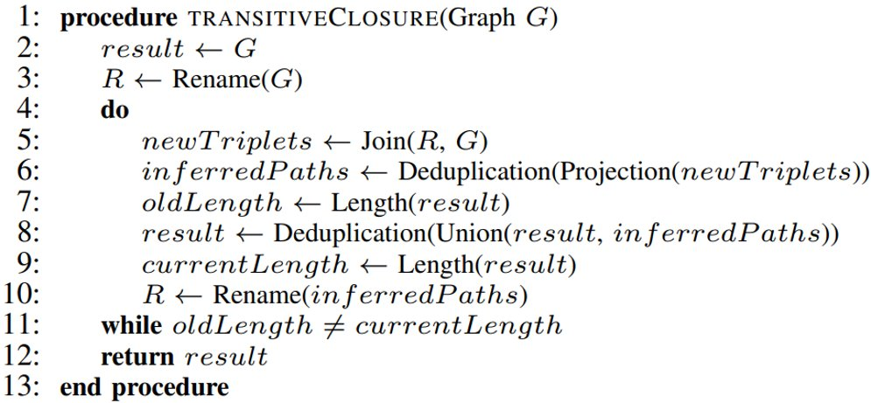
Algorithm for TC computation using DFRA
cuDF provides similar APIs to Pandas
Join using merge function
Projection and deduplicatoin using drop and drop_duplicates function
Union using concat function
A. R. Shovon, L. R. Dyken, O. Green, T. Gilray and S. Kumar, "Accelerating Datalog applications with cuDF," 2022 IEEE/ACM Workshop on Irregular Applications: Architectures and Algorithms (IA3), Dallas, TX, USA, 2022, pp. 41-45

Slide 56
Dataset: Stanford large network dataset collection
Graph​ | Type​ | Nodes​ | Edges​
p2p-Gnutella09​ | Directed​ | 8,114​ | 26,013​
p2p-Gnutella04​ | Directed​ | 10,876​ | 39,994​
Skitter​ | Undirected​ | 1,696,415​ | 11,095,298​
roadNet-CA​ | Undirected​ | 1,965,206​ | 2,766,607​
roadNet-TX​ | Undirected​ | 1,379,917​ | 1,921,660​
roadNet-PA​ | Undirected​ | 1,088,092​ | 1,541,898​
SF.cedge​ | Undirected​ | 1,74,955​ | 2,23,001​
cal.cedge​ | Undirected​ | 21,048​ | 21,693​
TG.cedge​ | Undirected​ | 18,263​ | 23,874​
OL.cedge​ | Undirected​ | 6,105​ | 7,035​
Leskovec, J., & Krevl, A. (2014). SNAP Datasets: Stanford large network dataset collection.

Slide 57
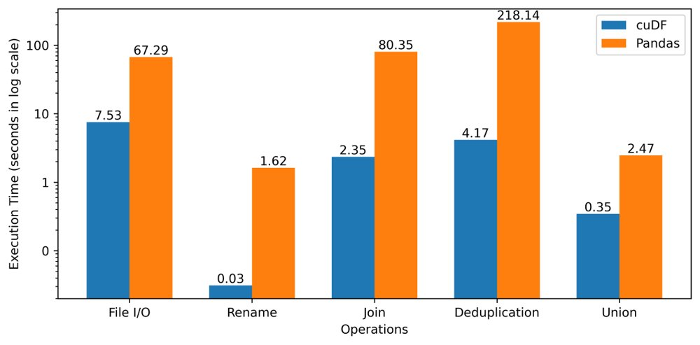
Performance Comparision: RA Operations
8.9x
52.2x
34.1x
52.4x
7.1x
A. R. Shovon, L. R. Dyken, O. Green, T. Gilray and S. Kumar, "Accelerating Datalog applications with cuDF," 2022 IEEE/ACM Workshop on Irregular Applications: Architectures and Algorithms (IA3), Dallas, TX, USA, 2022, pp. 41-45
Leadership Computing Facility, A. (2022). Argonne Leadership Computing Facility. Theta GPU Nodes. URL: https://www.alcf.anl.gov/support-center/theta-gpu-nodes

Slide 58
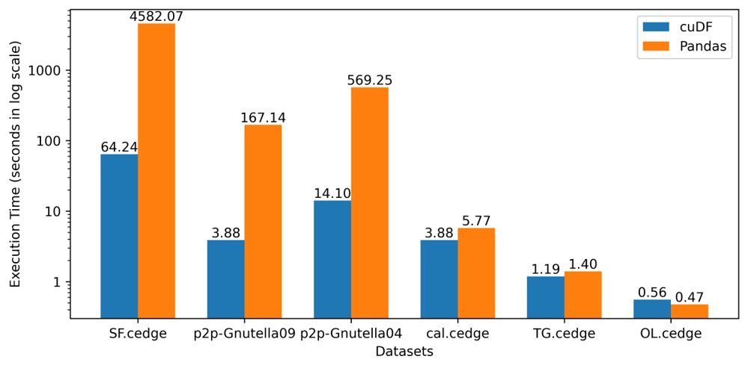
Performance Comparision: Transitive Closure
71.3x
43.1x
40.4x
1.5x
1.2x
0.9x
A. R. Shovon, L. R. Dyken, O. Green, T. Gilray and S. Kumar, "Accelerating Datalog applications with cuDF," 2022 IEEE/ACM Workshop on Irregular Applications: Architectures and Algorithms (IA3), Dallas, TX, USA, 2022, pp. 41-45
Leadership Computing Facility, A. (2022). Argonne Leadership Computing Facility. Theta GPU Nodes. URL: https://www.alcf.anl.gov/support-center/theta-gpu-nodes

Slide 59
DataFrame Based Datalog Applications
Advantages
Limitations
Abstract memory management
Abstract thread block configuration
Same API signatures for CPU and GPU
Easy-to-code interface
No fusing
Memory and computation overhead
No consecutive operation
Memory limitation
A. R. Shovon, L. R. Dyken, O. Green, T. Gilray and S. Kumar, "Accelerating Datalog applications with cuDF," 2022 IEEE/ACM Workshop on Irregular Applications: Architectures and Algorithms (IA3), Dallas, TX, USA, 2022, pp. 41-45
Green, O., Du, Z., Patel, S., Xie, Z., Liu, H., & Bader, D. A. (2021, December). Anti-Section Transitive Closure. In 2021 IEEE 28th International Conference on High Performance Computing, Data, and Analytics (HiPC) (pp. 192-201). IEEE.
Team, R. D. (2018). RAPIDS: Collection of libraries for end to end GPU data science. NVIDIA, Santa Clara, CA, USA. https://rapids.ai

Slide 60
CUDA Advantages over Dataframe
Fuse operations
Thread-block configuration
Memory management
Optimize data structure
Jason. Sanders. CUDA by example : an introduction to general-purpose GPU programming. AddisonWesley, Upper Saddle River, NJ, 2011.
John Cheng, Max Grossman, and Ty McKercher. Professional CUDA c programming. John Wiley & Sons, 2014

Slide 61
Improvement Opportunity for TC
Open-addressing based hashtable
Fuse join and projection
Sorted results for deduplication
Pinned memory scheme
Intermediate memory clearance
A. R. Shovon, L. R. Dyken, O. Green, T. Gilray and S. Kumar, "Accelerating Datalog applications with cuDF," 2022 IEEE/ACM Workshop on Irregular Applications: Architectures and Algorithms (IA3), Dallas, TX, USA, 2022, pp. 41-45
Green, O., Du, Z., Patel, S., Xie, Z., Liu, H., & Bader, D. A. (2021, December). Anti-Section Transitive Closure. In 2021 IEEE 28th International Conference on High Performance Computing, Data, and Analytics (HiPC) (pp. 192-201). IEEE.

Slide 62
Table of Contents
Exascale Computing
Iterative Relational Algebra
Datalog
Declarative Analytics using Datalog Applications
Topological Data Analysis for High-Dimensional Data
Future Research Direction

Slide 63
Topological Data Analysis
TDA analyzes high-dimensional data sets using algebraic topology
Main tool: persistent homology, adapts homology to point cloud
Analyzes complex systems: social networks, brain connectivity, internet
Extracts topological features and visualizes in lower-dimensional space
M. Rubinov and O. Sporns, “Complex network measures of brain connectivity: uses and interpretations,” Neuroimage, vol. 52, no. 3, pp. 1059–1069, 2010.
Aktas, M.E., Akbas, E. & Fatmaoui, A.E. Persistence homology of networks: methods and applications. Appl Netw Sci 4, 61 (2019). https://doi.org/10.1007/s41109-019-0179-3

Slide 64
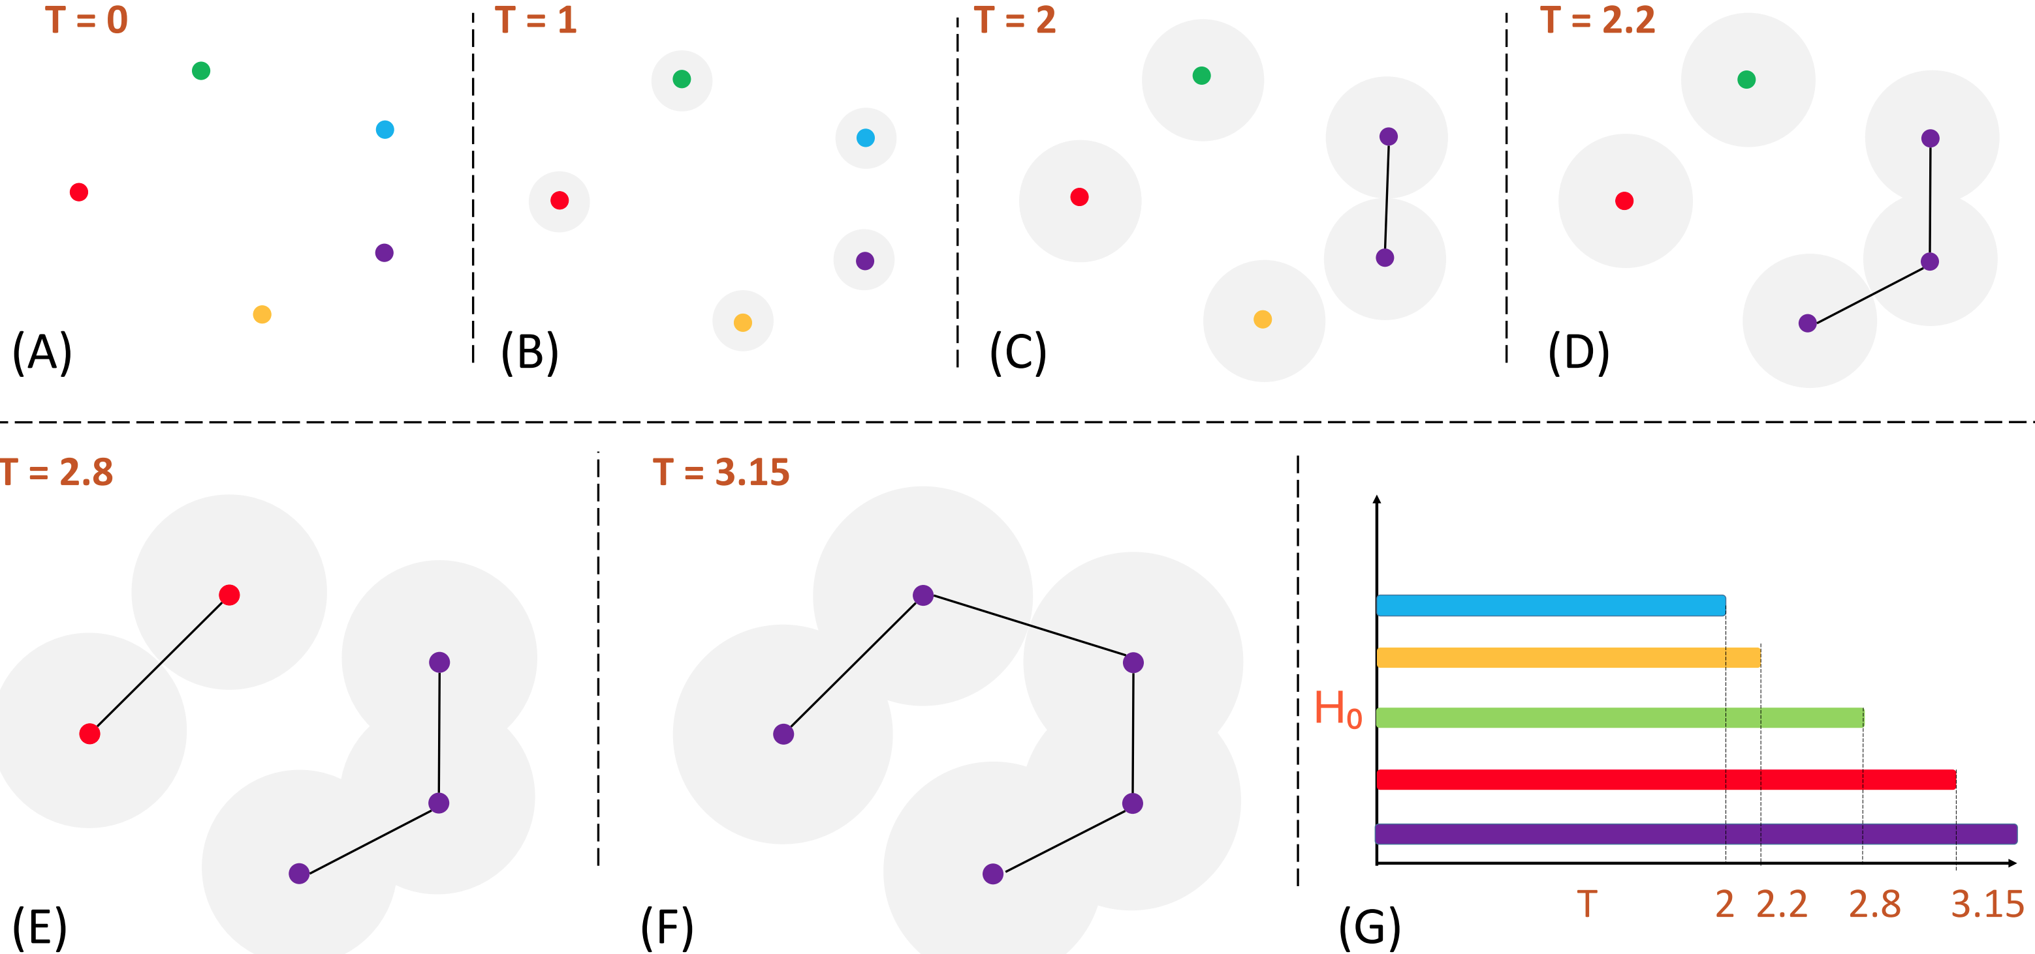
Computing Persistent Homology (Point Cloud)

Slide 65
Computing Persistent Homology (Point Cloud)

Slide 66
Computing Persistent Homology (Point Cloud)

Slide 67
Computing Persistent Homology (Point Cloud)

Slide 68
Computing Persistent Homology (Point Cloud)

Slide 69
Computing Persistent Homology (Point Cloud)

Slide 70
Functional Connectivity Networks Analysis
FCNs use Pearson's correlation to measure time series association
Multi-site rs-fMRI studies recruit faster, larger samples
Sensitive to data acquisition parameters (sampling rates)
Non-neural variability negates advantages of larger sample sizes
B. B. Biswal, M. Mennes, X.-N. Zuo, S. Gohel, C. Kelly, S. M. Smith, C. F. Beckmann, J. S. Adelstein, R. L. Buckner, S. Colcombe et al., “Toward discovery science of human brain function,” Proceedings of the national academy of sciences, vol. 107, no. 10, pp. 4734–4739, 2010.
C. Dansereau, Y. Benhajali, C. Risterucci, E. M. Pich, P. Orban, D. Arnold, and P. Bellec, “Statistical power and prediction accuracy in multisite resting-state fmri connectivity,” Neuroimage, vol. 149, pp. 220–232, 2017.

Slide 71
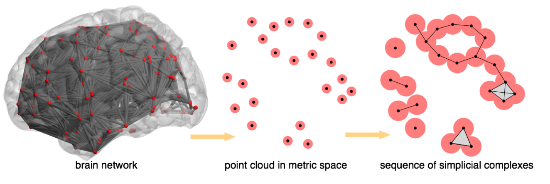
Preserve Brain Topology
Topology of brain networks should be preserved irrespective of sampling density
Metrics capturing topology may be statistically similar across sampling periods, reducing non-neural variability
PH can be robust to changes in data acquisition parameters like sampling period
A. Patania, F. Vaccarino, and G. Petri, “Topological analysis of data,” EPJ Data Science, vol. 6, pp. 1–6, 2017.
Bourakna, A.E.Y., Chung, M.K., Ombao, H. 2022 Topological data analysis for multivariate time series data arXiv:2204.13799

Slide 72
PH for High-Dimensional Data Analysis
Verify
PH of rs-fMRI can compactly represent topological features of FCNs
Demonstrate
FCN networks are statistically similar despite variations in TRs
Remove
Non-neural variability in multi-site case-control studies
Ashley Suh, Mustafa Hajij, Bei Wang, Carlos Scheidegger, and Paul Rosen. Persistent homologyguided force-directed graph layouts. IEEE Transactions on Visualization and Computer Graphics,26(1):697–707, January 2020
Tananun Songdechakraiwut, Li Shen, and Moo Chung. Topological learning and its application tomultimodal brain network integration. In Medical Image Computing and Computer Assisted Intervention–MICCAI 2021: 24th International Conference, Strasbourg, France, September 27–October 1, 2021,Proceedings, Part II 24, pages 166–176. Springer, 2021.

Slide 73
Table of Contents
Exascale Computing
Iterative Relational Algebra
Datalog
Declarative Analytics using Datalog Applications
Topological Data Analysis for High-Dimensional Data
Future Research Direction

Slide 74
Future Research Direction
Develop a multi-node multi-GPU backend for Datalog to perform iterated relational algebra operations tailored for GPU
Design benchmarking techniques to for GPU programming models to analyze GPU-based implementation of iterative join
Extend the state-of-the-art multi-node CPU-based Datalog-like language SLOG to leverage our GPU-based solutions

Slide 75
Future Research Direction (Continue)
Explore PH-based techniques to handle non-neural variability issues generated by using different TRs from brain FCNs on temporal dynamics
Develop novel declarative analytics technique to provide insights from complex high-dimensional datasets
Integrate advanced algorithms and techniques of TDA (PH) with Datalog-enabled declarative analytics on supercomputers

Slide 76
Conclusion
Reviewed Datalog applications on heterogeneous systems
Explored topological data analysis techniques for brain network
Identified research direction for declarative analytics on high-dimensional data

Slide 77
Publications
Ahmedur Rahman Shovon, Landon Richard Dyken, Oded Green, Thomas Gilray, and Sidharth Kumar. Accelerating datalog applications with cudf. In 2022 IEEE/ACM 11th Workshop on Irregular Applications: Architectures and Algorithms (IA3), pages 41–45, 2022
Sidharth Kumar, Ahmedur Rahman Shovon, and Gopikrishna Deshpande. The invariance of persistent homology of brain networks to data acquisition-related non-neural variability in resting state fmri. Human Brain Mapping, in revise
Darshan Shimoga Chandrashekar, Santhosh Kumar Karthikeyan, Praveen Kumar Korla, Henalben Patel, Ahmedur Rahman Shovon, Mohammad Athar, George J Netto, Zhaohui S Qin, Sidharth Kumar, Upender Manne, et al. Ualcan: An update to the integrated cancer data analysis platform. Neoplasia, 25:18–27, 2022.
Ahmedur Rahman Shovon, Thomas Gilray, Kristopher Micinski, and Sidharth Kumar. Towards Iterative Relational Algebra on the GPU. In 2023 USENIX Annual Technical Conference (USENIX ATC 23), under review

Slide 78
Thank you!

Slide 79
Appendix

Slide 80
Join on CPUs
Processing large amounts of data is a challenging task
Radix hash joins and sort-merge joins have been widely discussed and compared in previous studies
Modern HPC architectures have led to advancements in distributed join algorithms
Most of the multi-core implementations use Message Passing Interface (MPI)
Fundamental part of fixed-point iterative algorithm such as Transitive Closure (TC)

Slide 81
Join on GPUs
GPUs have high memory bandwidth and hierarchy for faster data access
GPUs offer parallel architecture for faster join operation
Data divided into smaller subsets for parallel processing
GPU-based join operation improves performance and scalability

Slide 82
Datalog on GPUs
Outperforms non-GPU systems for join and transitive closure computation
Use GPU kernels to eliminate unnecessary tuples, join, and project
Achieved up to 40x performance enhancement over single CPU system
Limitation in relation size and applicability to distributed platforms
Carlos Alberto Mart´ınez-Angeles, Inˆes Dutra, V´ıtor Santos Costa, and Jorge Buenabad-Ch´avez. Adatalog engine for gpus. In Declarative Programming and Knowledge Management: DeclarativeProgramming Days, KDPD 2013, Unifying INAP, WFLP, and WLP, Kiel, Germany, September 11-13,2013, Revised Selected Papers 0, pages 152–168. Springer, 2014.
Grigoris Antoniou, Sotiris Batsakis, Raghava Mutharaju, Jeff Z. Pan, Guilin Qi, Ilias Tachmazidis,Jacopo Urbani, and Zhangquan Zhou. A survey of large-scale reasoning on the web of data. TheKnowledge Engineering Review, 33, 2018.

Slide 83
Persistent Homology (PH)
Investigates connections between different parts of complex networks using simplicial complexes
Simplicial complexes represent topological spaces as collections of simplices (points, line segments, triangles, etc.)
Detects topological features and measures the significance of relationships across multiple thresholds
Topological features refer to the 0-, 1-, 2- dimensional homology groups of a metric space describing connected components, tunnels, and voids
0-simplex (connected component)
1-simplex (tunnel)
2-simplex (void)
M. Rubinov and O. Sporns, “Complex network measures of brain connectivity: uses and interpretations,” Neuroimage, vol. 52, no. 3, pp. 1059–1069, 2010.
Aktas, M.E., Akbas, E. & Fatmaoui, A.E. Persistence homology of networks: methods and applications. Appl Netw Sci 4, 61 (2019). https://doi.org/10.1007/s41109-019-0179-3

Slide 84
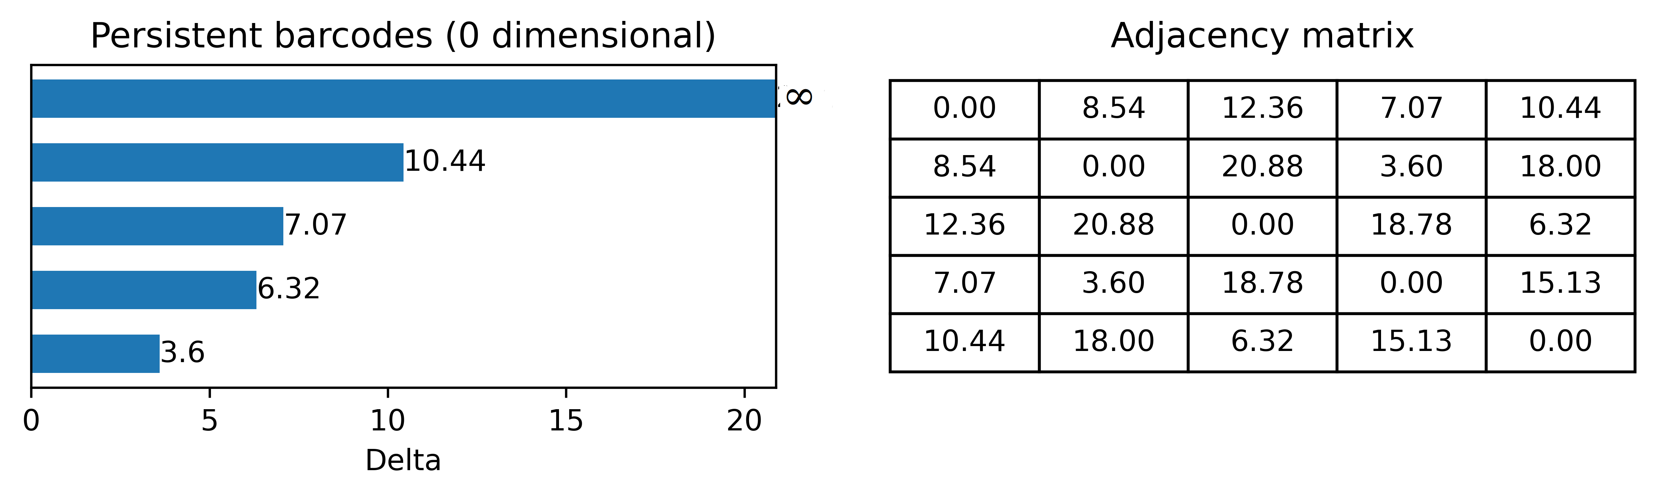
Barcodes and Persistent Diagram
PH can track when features are created and destroyed with varying scales
Quantifies birth and death of features in the graph according to their significance
Represented in the form of barcodes, a fingerprint for a graph
Persistent diagram: points in 2D plane obtained from barcodes, represent topological feature persistence with x as birth time and y as death time
Aktas, M.E., Akbas, E. & Fatmaoui, A.E. Persistence homology of networks: methods and applications. Appl Netw Sci 4, 61 (2019). https://doi.org/10.1007/s41109-019-0179-3

Slide 85
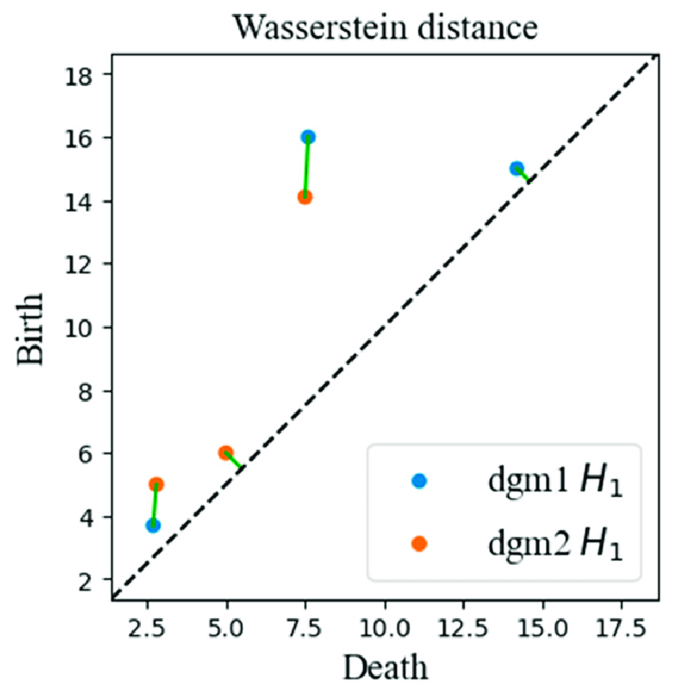
Wasserstein distance (WD)
Wasserstein distance (Earth Mover's Distance) measures distance between two probability distributions
Minimum amount of work required to transform u into v, work = distribution weight x distance
Minimum value achieved by a perfect matching between the features of two Persistent Diagrams
S. Vallender, “Calculation of the wasserstein distance between probability distributions on the line,” Theory of Probability & Its Applications, vol. 18, no. 4, pp. 784–786, 1974.
H. Edelsbrunner, “Persistent homology: theory and practice,” 2013.
Qingzhang, Shi. (2021). Time Series Clustering with Topological and Geometric Mixed Distance. Mathematics. 9. 10.3390/math9091046.

Slide 86
Experimental data and network construction
Structural T1-weighted and rs-fMRI data were obtained from the publicly available Enhanced Nathan Kline Institute Rockland Sample database (NKI-RS)
The MRI data from 3T Siemens Magnetom Tim Trio scanner
The rs-fMRI data were acquired from each subject using 3 acquisition protocols with 3 temporal sampling rates (645ms, 1400ms, 2500ms)
Total number of subjects: 316 with mean time series from 113 brain regions
One weighted network per fMRI scan
K. B. Nooner, S. Colcombe, R. Tobe, M. Mennes, M. Benedict, A. Moreno, L. Panek, S. Brown, S. Zavitz, Q. Li et al., “The nki-rockland sample: a model for accelerating the pace of discovery science in psychiatry,” Frontiers in neuroscience, vol. 6, p. 152, 2012.

Slide 87
Embed FCNs in metric space
To map the association between two nodes u and v in the brain network, their Pearson's correlation coefficients corr(u, v) are used
The objective is to transform this association into a distance metric where stronger correlations between nodes correspond to shorter distances
Mapping to all 316 subjects across 3 temporal frequencies:
d(u, v) = 1 – corr(u, v)
Included both positive and negative correlations
Generates symmetric adjacency matrix with size 113 x 113 using Pearson's correlation
Total adjacency matrices: 948 (316 x 3)
B. Cassidy, C. Rae, and V. Solo, “Brain activity: Conditional dissimilarity and persistent homology,” in 2015 IEEE 12th International Symposium on Biomedical Imaging (ISBI), 2015, pp. 1356–1359.
S. M. Smith, K. L. Miller, G. Salimi-Khorshidi, M. Webster, C. F. Beckmann, T. E. Nichols, J. D. Ramsey, and M. W. Woolrich, “Network modelling methods for fmri,” Neuroimage, vol. 54, no. 2, pp. 875–891, 2011.

Slide 88
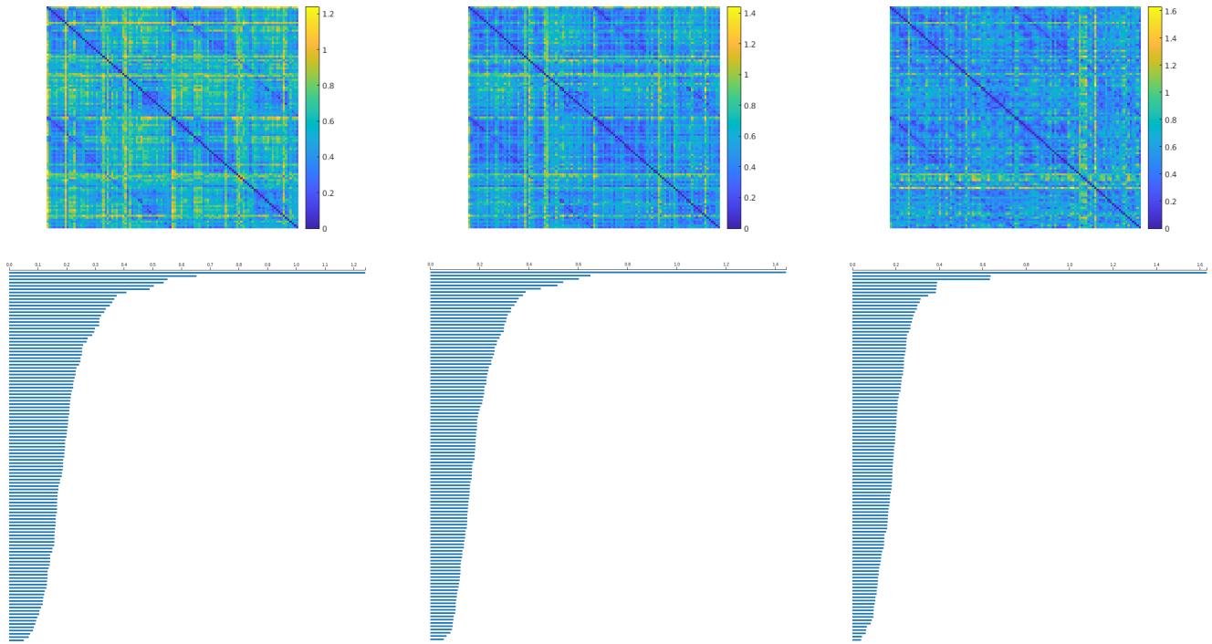
Apply PH to metric space
Apply PH on the metric space to extract topological features
Compute 0-dimensional barcodes for all FCNs (3 x 316)
FCN (top-row) and extracted topological feature (bottom-row) for subject 31 for 645ms (left), 1400ms (center), and 2500ms (right)
The GUDHI Project, GUDHI User and Reference Manual. GUDHI Editorial Board, 2015. [Online]. Available: http://gudhi.gforge.inria.fr/doc/latest/
M. Kerber, D. Morozov, and A. Nigmetov, “Geometry helps to compare persistence diagrams,” Journal of Experimental Algorithmics (JEA), vol. 22, pp. 1–20, 2017.

Slide 89
Statistical analysis on PDs
Convert extracted barcodes to persistent diagram (PD)
Quantify the difference between two PDs using Wasserstein distance
Wasserstein metrics provides the foundation of the statistical inference framework
Performed 3 kinds of statistical analysis:
Across cohort study
Within cohort study
Comparision with traditional FCN analysis
S. Vallender, “Calculation of the wasserstein distance between probability distributions on the line,” Theory of Probability & Its Applications, vol. 18, no. 4, pp. 784–786, 1974.
H. Edelsbrunner, “Persistent homology: theory and practice,” 2013.

Slide 90
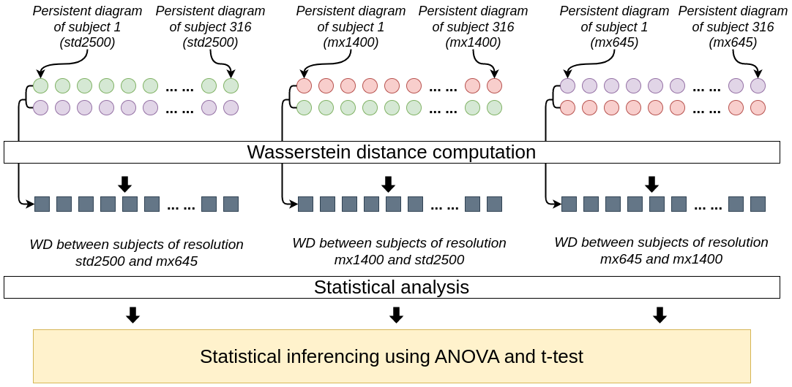
Across Cohort Study
Perform comparison of PDs across cohorts using Wasserstein distance
For each subject compute 3 WD
2500ms and 645ms
1400ms and 2500ms
645ms and 1400ms
Form 3 distributions each with 316 datapoints
Apply Analysis of Variance (ANOVA) and t-test on the distributions
High p-value (>0.05) will indicate the null hypothesis is true
Pipeline to compare WD across cohorts
R. T. Shinohara, J. Oh, G. Nair, P. A. Calabresi, C. Davatzikos, J. Doshi, R. G.Henry, G. Kim, K. A. Linn, N. Papinutto et al., “Volumetric analysis from a harmonized multisite brain mri study of a single subject with multiple sclerosis,” American Journal of Neuroradiology, vol. 38, no. 8, pp. 1501–1509, 2017.

Slide 91
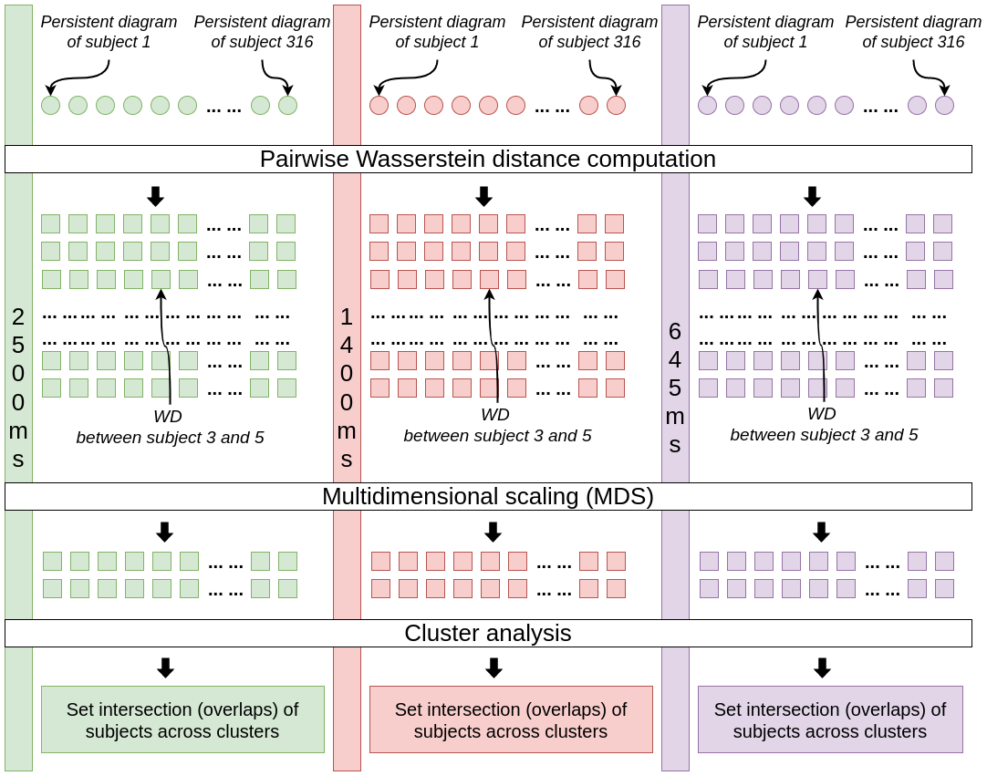
Within Cohort Study
Perform comparison of pairwise WD between PDs of subjects within each cohort
Generate 3 adjancency matrix of size 316 x 316
Reduce the dimension using 2-components MDS (matrix size 316 x 2)
Apply K-Means clustering with Silhoutte coefficient
Computes set interaction of the subjects across clusters
Pipeline to compare WD within a given cohort
Chung, M. K., Huang, S. G., Carroll, I. C., Calhoun, V. D., & Goldsmith, H. H. (2022). Dynamic Topological Data Analysis for Brain Networks via Wasserstein Graph Clustering. arXiv preprint arXiv:2201.00087.

Slide 92
Comparison with traditional FCN analysis
Use raw FCN instead of using PH features
Perform ANOVA test across all subjects for each node of the raw FCN
Compute 1 p-value per entry of the FCN
As FCN size is 113 x 113, generates 113 x 113 p-values
Threshold the p-values with significance level of α = 0.05
Assign 1 if p-value is less than the threshold, 0 otherwise
If majority of the value are 1, then it will indicate that FCN acquired from different sampling periods are different
Feng, W., Liu, G., Zeng, K., Zeng, M., & Liu, Y. (2022). A review of methods for classification and recognition of ASD using fMRI data. Journal of neuroscience methods, 368, 109456.

Slide 93
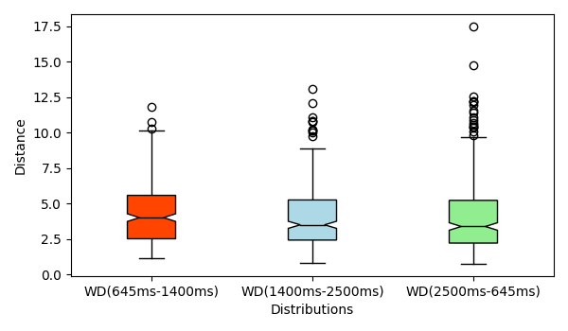
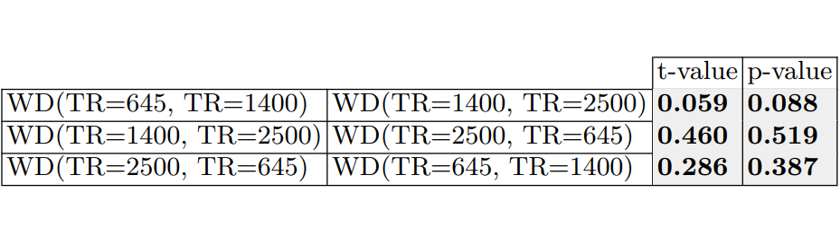
Across Cohort Study Results
Boxplots are aligned indicating similarity of the three distributions
ANOVA test yields p-value of 0.29
T-values and p-values are greater than the significance level of α = 0.05
Boxplot and t-test results for across study, significance level of α = 0.05

Slide 94
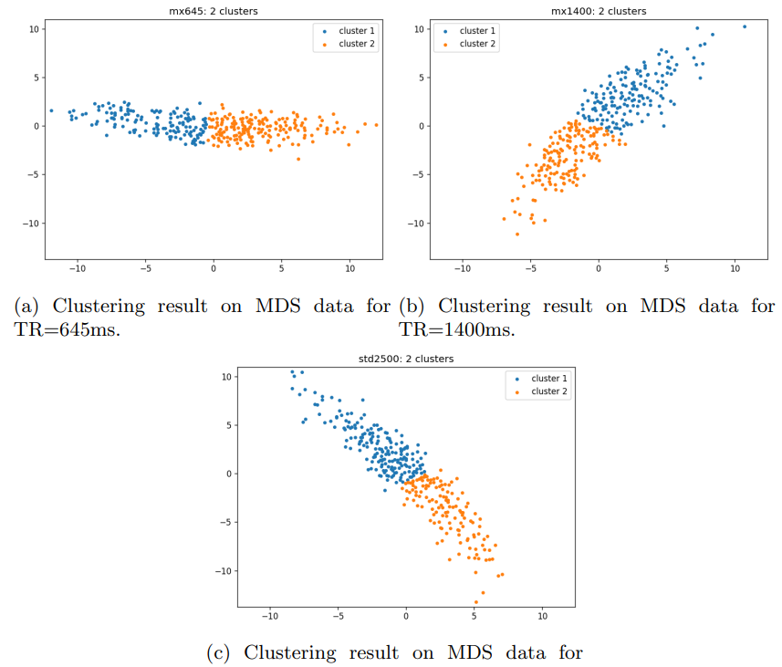
Within Cohort Study Results
Apply K-Means clustering with Silhoutte score on 2-components MDS, 3 matrices (316 X 2)
198 out of 316 subjects reside in same cluster group in all 3 TRs
251 out of 316 subjects reside in same pairwise cluster intersection
Compared against random FCNs which which gave p-value of 0
MDS plots of three data cohorts

Slide 95
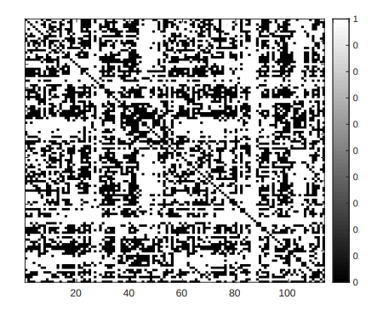
Comparison with traditional FCN analysis results
Majority pixels are black corresponding to a p-value < significance level of α = 0.05
7731 connections show FCNs are different for 3 TRs while 5037 connections are not
Traditional FCN analysis fails to identify connections from same subjects with different TRs
Results after ANOVA test on raw FCNs of 316 subjects, white pixels indicate no matching of the same subject across different TRs

